Slide 1
UML & Object Oriented Analysis and Design
Notes:
To be sure you are prepared to take this course, can you answer yes to the following questions?
• Do you have a general understanding of a programming language?
• Do you have an understanding of the fundamentals of the software system development process?

Slide 2
Course objective
Course objective
Appreciate the Fundamentals of OOAD
Modeling techniques and description
System analysis
System design
Notes:
[Wiki]Methodology is usually a guideline system for solving a problem, with specific components such as phases, tasks, methods, techniques and tools.It can be defined also as follows:
"the analysis of the principles of methods, rules, and postulates employed by a discipline";
"the systematic study of methods that are, can be, or have been applied within a discipline";
"the study or description of methods".
A methodology can be considered to include multiple methods, each as applied to various facets of the whole scope of the methodology. The research can be divided between two parts, they are qualitative research and quantitative research.

Slide 3
OOAD History & Basics
Objectives
Why model?
How to build models?
OO basics & UML notations.

Slide 4
Why Model?
System to be done
Structure & behavior
Visualization
Specification
Four
Aims
Template
Documentation
Guide to constructing a system.
Decisions
Notes:
According to Booch in The Unified Modeling Language User Guide, modeling achieves four aims:
1. Models help you to visualize a system, as you want it to be. A model helps the software team communicate the vision for the system being developed. It is difficult for a software team to have a unified vision of a system that is described only in specification and requirement documents.
2. Models permit you to specify the structure or behavior of a system. A model allows how to document system behavior and structure before coding the system.
3. Models give a template that guide you in constructing a system. A model is an invaluable tool during construction. It serves as a road map for a developer. Have you experienced a situation where a developer coded incorrect behavior because he or she was confused over the wording in a requirements document? Modeling helps alleviate that situation.
4. Models document the decisions you’ve made. You don’t need to rely on someone’s memory.
You build models of complex systems because you cannot comprehend such a system in its entirety.You build models to better understand the system you are developing.

Slide 5
Principles of Modeling
Why Model?
Create influences how the problem is attacked.
Expressed at different levels of precision.
Principles of Modeling
The best models are connected to reality.
No single model is sufficient.
Notes:
Modeling has a rich history in all the engineering disciplines. The four basic principles of modeling are derived from this history.
The models you create profoundly influence how a problem is attacked and how a solution is shaped.
Every model may be expressed at different levels of precision.
The best models are connected to reality.
No single model is sufficient. Every non-trivial system is best approached through a small set of nearly independent models.

Slide 6
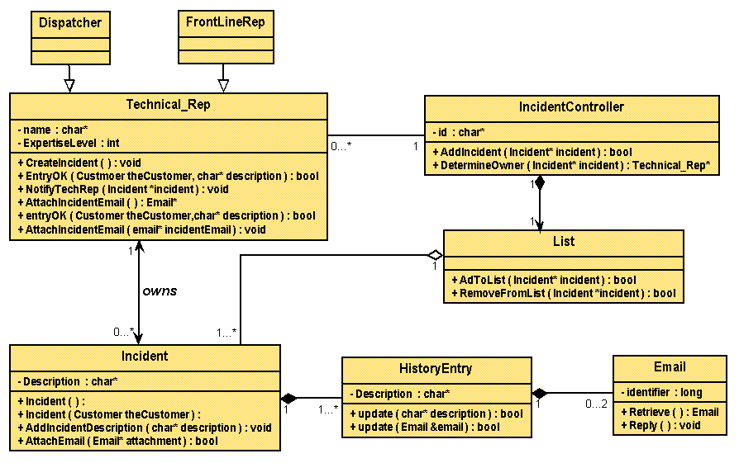
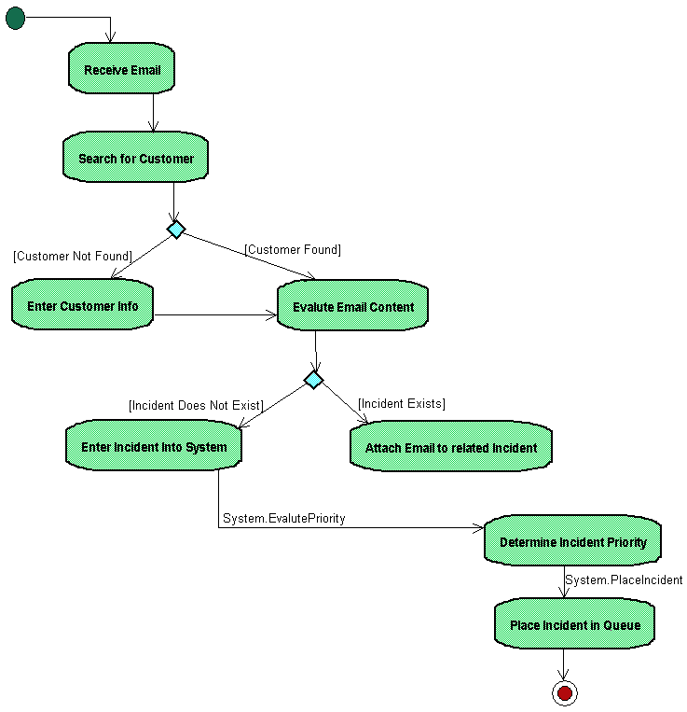
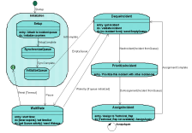
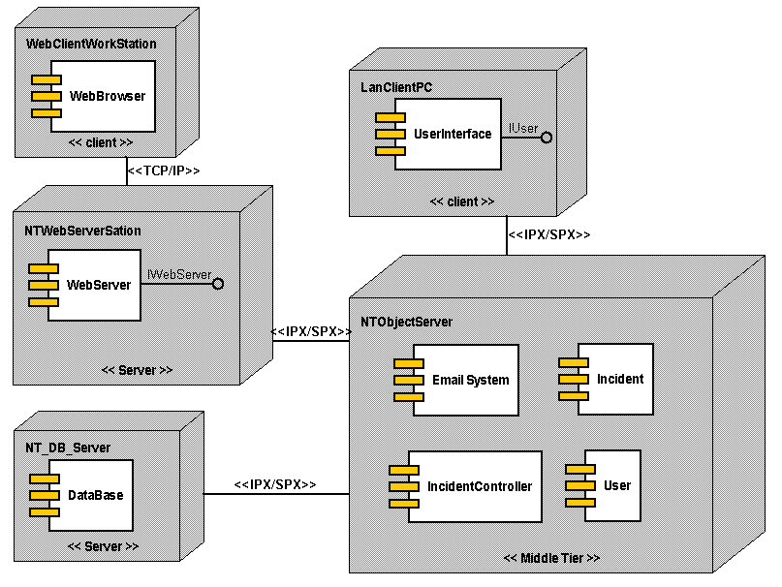
Software Architecture: The “4+1 View” Model
How to build models?
Logical View
Implementation View
Analysts/Designers
Programmers
Structure
Software management
Use-Case View
End-user
Functionality
Process View
Deployment View
System engineering
System integrators
System topology, delivery,
installation, communication
Performance, scalability, throughput
Notes:
The above diagram shows the model Rational uses to describe the software architecture.
Architecture is many things to many different interested parties. On a particular project, there are usually multiple stakeholders, each with their own concerns and view of the system to be developed. The goal is to provide each of these stakeholders with a view of the system that addresses their concerns, and suppresses the other details.
To address these different needs, Rational has defined the “4+1 view” architecture model. An architectural view is a simplified description (an abstraction) of a system from a particular perspective or vantage point, covering particular concerns, and omitting entities that are not relevant to this perspective. Views are “slices” of models.
Not all systems require all views (for example, single processor: drop Deployment View; single process: drop Process View; small program: drop Implementation View, and so forth). A project may document all of these views or additional views. The number of views is dependent on the system you are building.

Slide 7
How to build models? - UMLNotation
Process Activities
Requirements
Analysis and Design
Implementation
System Models
Use Case Model
Design Model
Deployment Model
Implementation Model
UML Diagrams
Use Case Diagram
Class Diagram
Deployment Diagram
Component Diagram
Activity Diagram
Sequence Diagram
Collaboration Diagram
Statechart Diagram
Notes:
Notation: A set of symbols, and the rules for their use, for the representation of data.
What is UML? → “Unified Modeling Language”
Unified: UML has become a world standard.
Modeling :Describing a software system at a high level of abstraction.
Language: More comprehensible, ready-to-use, expressive, and visualing.
Goals of UML:
Provide extensibility and specialization mechanisms to extend the core concepts
Be independent of particular programming languages and development processes
Provide a formal basis for understanding the modeling language
Encourage the growth of the OO tools market.
Support higher-level development concepts such as collaborations, frameworks, patterns and components.

Slide 8
OOAD
Contents
Object-Oriented Software Development (OOSD) process & UML guide
OOAD with UML notations.

Slide 9
Discussion
What major problems have you encountered during software projects?
Estimate what percentage of your time you spend on analysis, design, coding, and testing/debugging/fixing.

Slide 10
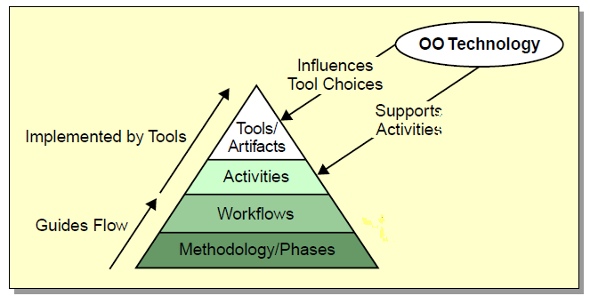
OOAD - Software Methodology
The OOSD Hierarchy
Notes:
A methodology is “a body of methods, rules, and postulates employed by a discipline” [Webster New Collegiate Dictionary]
• In OOSD, methodology refers to the highest-level organization of a software project.
• This organization can be decomposed into medium-level phases. Phases are decomposed into workflows. Workflows are decomposed into activities.
• Activities transform the artifacts from one workflow to another. The output of one workflow becomes the input into the next.
• The final artifact is a working software system that satisfies the initial artifact: the system requirements.

Slide 11
OOAD - Workﬂows of the OOSD Process(1/2)
Software development has traditionally encompassed the following workﬂows:
OOSD
Requirements Analysis
Architecture
Design
Implementation
Testing
Deployment
Requirements Gathering

Slide 12
OOAD - RUP(case in point)
Notes:
This slide illustrates how phases and iterations (the time dimension) relate to the development activities (the discipline dimension). The relative size of each color area in the graph indicates how much of the activity is performed in each phase or iteration.Each iteration involves activities from all disciplines. The relative amount of work related to the disciplines changes between iterations. This is a brief summary of the RUP disciplines:
Business Modeling – Encompasses all modeling techniques you can use to visually model a business.
Requirements – Defines what the system should do.
Analysis & Design – Shows how the system's use cases will be realized in implementation.
Implementation – Implements software components that meet quality standards.
Test – Integrates and tests the system.
Deployment - Provides the software product to the end-user.
Configuration & Change Management – Controls and tracks changes to artifacts.
Project Management – Ensures tasks are scheduled, allocated and completed in accordance with project schedules, budgets and quality requirements.
Environment – Defines and manages the environment in which the system is being developed.

Slide 13



OOAD - Exploring the Beneﬁts of Modeling Software
create a series of conceptual models
software project
realization
development team
inception
production system
Notes:
The inception of every software project starts as an idea in
someone’s mind.
To construct a realization of that idea, the development team
must create a series of conceptual models that transform the
idea into a production system.
Software development can be viewed as a series of transformations from the Stakeholder’s mental model to the actual code.

Slide 14
OOAD - Deﬁning the UML
“The Uniﬁed Modeling Language (UML) is a graphical language for visualizing, specifying, constructing, and documenting the artifacts of a software-intensive system.”
Using the UML, a model is composed of:
• Elements (things and relationships)
• Diagrams (built from elements)
• Views (diagrams showing different perspectives of a
model)
Deﬁning the UML
Notes:
What UML Is and Is Not
UML is not:
Used to create an executable model
A programming language
A methodology
But it:
Can be used to generate code skeletons
Maps to most OO languages
Can be used as a tool within the activities of a methodology
14

Slide 15
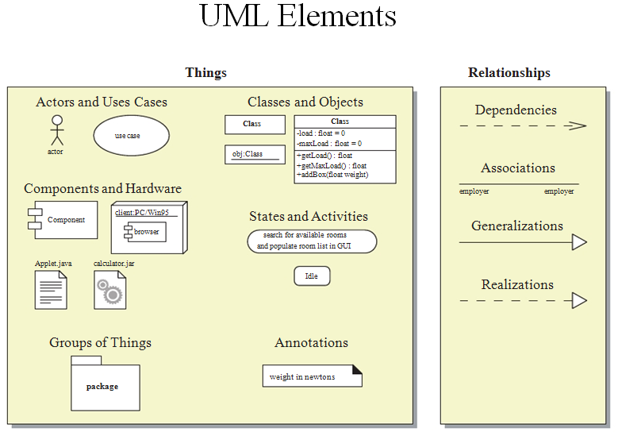
OOSD Process & UML guide

Slide 16
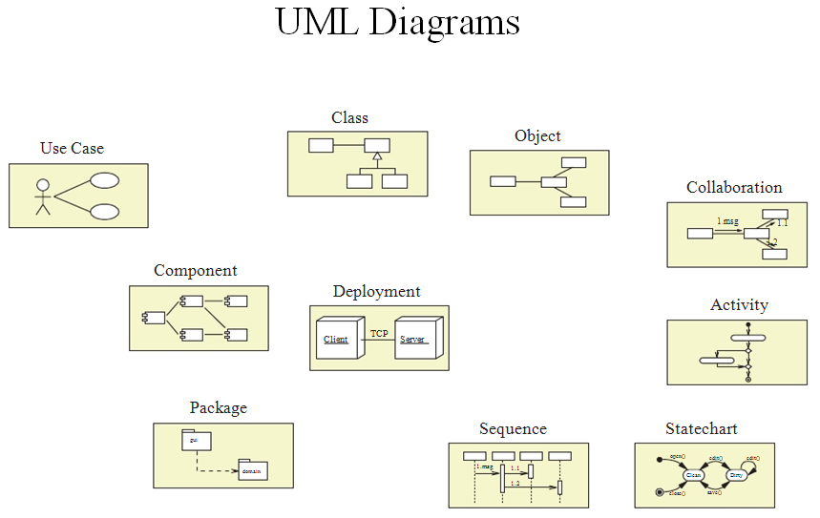
OOSD Process & UML guide

Slide 17
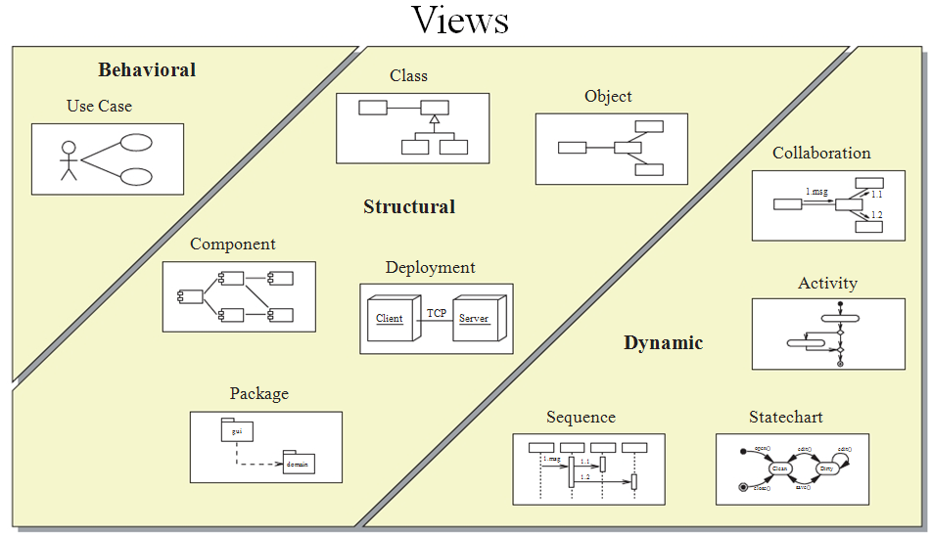
OOSD Process & UML guide
Notes:
UML Tools
UML itself is a tool. You can create UML diagrams on paper or a white board. However, software tools are available to:
Provide computer-aided drawing of UML diagrams
Support (or enforce) semantic verification of diagrams
Provide support for a specific methodology
Generate code skeletons from the UML diagrams
Organize all of the diagrams for a project.
Automatic generation of modeling elements for design
patterns, Java™ 2 Platform, Enterprise Edition (J2EE™
platform) components, and so on

Slide 18
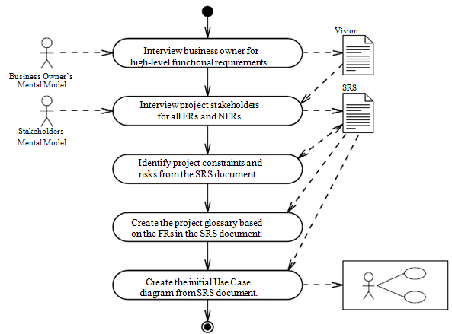
OOSD Process & UML guide
Activities and Artifacts of the Requirements Gathering Workflow
Notes:
Artifacts: one of many kinds of tangible byproducts produced during the development of software.(wikipedia)
Requirements Gathering: Determine what the system must do
• With whom the system interacts (actor)
• What behaviors (called use cases) that the system must support
• Detailed functional requirements for each use case
• Non-functional requirements

Slide 19
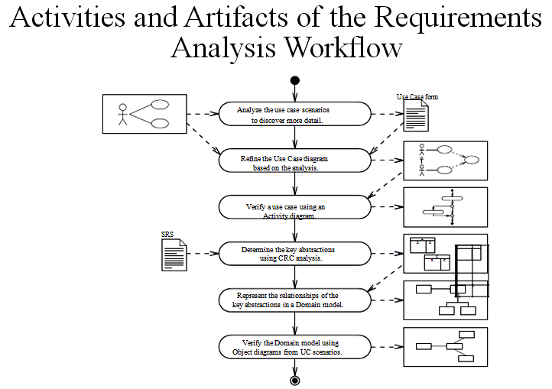
OOSD Process & UML guide
Notes:
Requirements Analysis:Model how the system will support the use cases
Determine:
• A reﬁned Use Case diagram.
• What key abstractions exist in the system.

Slide 20
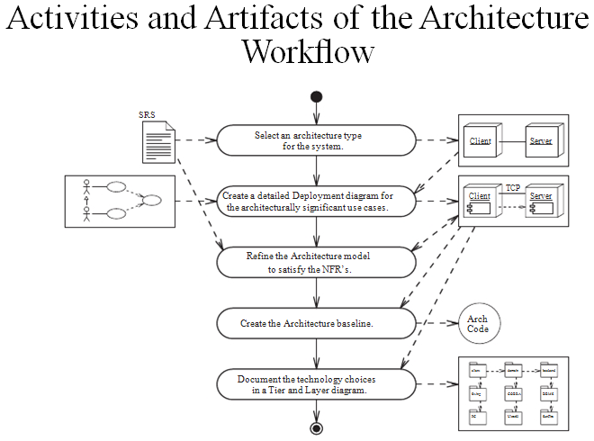
OOSD Process & UML guide
Notes:
Architecture:Model the high-level system structure to satisfy NFRs
Develop the highest-level structure of the software solution.
• Identify the technologies that will support the Architecture model.
• Elaborate the Architecture model with Architectural patterns to satisfy NFRs.

Slide 21
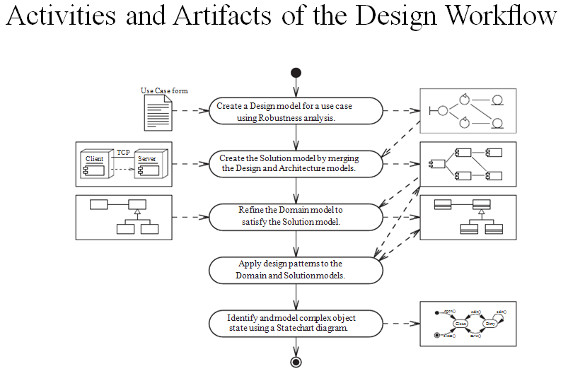
OOSD Process & UML guide
Notes:
Design:Model how the system will support the use cases.
• Create a Design model for a use case.
• Reﬁne the Domain model.
• Apply design patterns to the Domain and Solution models.
• Model a complex object state.

Slide 22
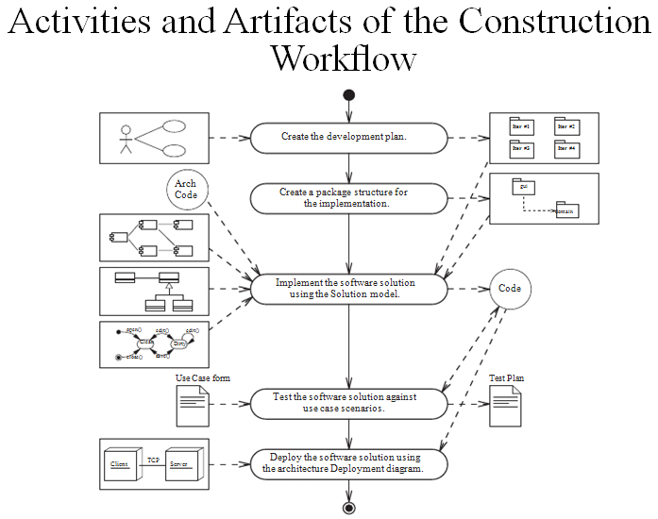
OOSD Process & UML guide
Notes:
Construction:Implement, test,and deploy the system
• Implement the software.
• Perform testing.
• Deploy the software to the production environment.

Slide 23
OOSD Process & UML guide
Summary
• The OOSD process starts with gathering the system requirements and ends with deploying a working system.
• Workflows define the activities that transform the artifacts of the project from the requirements model to the implementation code (the final artifact).
• The UML supports the creation of visual artifacts that represent views of your models.

Slide 24
Discussion
Recall a past system that you created. Briefly describe it. What obstacles did you encounter in the design?
What software engineering methodology, if any did you use?
What were your reasons for choosing or not choosing a methodology?
Are you satisfied with the system as it exists? How difficult is it to add new features to the system?
Is it maintainable?

Slide 25
OOAD
Contents
Object-Oriented Software Development (OOSD) process & UML guide
OOAD with UML notations.

Slide 26
OOAD with UML notations - Use Case Modal
Upon completion of this module, you should be able to:
• Identify and describe the essential elements in a UMLUse Case diagram
• Develop a Use Case diagram for a software system based on the SRS
Objectives

Slide 27
Relevant Requirements Artifacts
Use-Case Model
Glossary
Actors
Use Cases
...
Supplementary
Specification
Use-Case Specifications
Notes:
The Use-Case Model describes what the system will do. The Use-Case Model serves as a contract between the customer, the users, and the system developers. It allows customers and users to validate that the system will become what they expected and allows system developers to ensure that what they build is what is expected. The Use-Case Model consists of use cases and actors. Each use case in the model is described in detail, showing step-by-step how the system interacts with the actors and what the system does in the use case. The Use-Case Specification is the document where all of the use-case properties are documented (for example, brief description and use-case flows of events).
The Glossary defines a common terminology for all models and contains textual descriptions of the required system.
The Supplementary Specification contains those requirements that do not map to a specific use case (for example, nonfunctional requirements). The Supplementary Specification is an important complement to the Use-Case Model. Together they capture all requirements (functional and nonfunctional) that need to be described for a complete System Requirements Specification.

Slide 28
Use Case Diagrams
What ? - Behavior diagrams
Actors.
Behaviors.
Why?
The SRS is filled with detailed requirements. Also, the SRS is predominately text-based.
The client-side stakeholders need a big picture view of the system.
The system’s use cases form the basis for which all development is focused.
Notes:
Use case diagrams are behavior diagrams used to describe a set of actions (use cases) that some system or systems (subject) should or can perform in collaboration with one or more external users of the system (actors). Each use case should provide some observable and valuable result to the actors or other stakeholders of the system.
Use case diagrams are used to specify:
(external) requirements on a subject, required usages of a system - to capture what a system under construction is supposed to do;
the functionality offered by a subject – what system can do;
requirements the specified subject poses on its environment - by defining how environment should interact with the subject so that it will be able to perform its services.
System behavior is how a system acts and reacts.It is the outwardly visible and testable activity of a system.
System behavior is captured in use cases.Use cases describe the system, its environment, and the relationship between the system and its environment.

Slide 29
Use Case Diagrams
How?
Actor
An external person, process or thing interacting with a system, subsystem, or class
User Case
Each describes a possible kind of interaction between an actor and the system
Use cases are actions that a user takes on a system
System
The entity that we are going to build
Can have subsystems in it
Relationship
Connection between actors and use cases or use cases and use cases.
The first represents communication, the second represents higher level relationship
Notes:
An actor represents a coherent set of roles that users of the system play when interacting with these use cases. Typically, an actor represents a human, a hardware device, or some other external system. In UML 2, actors should be named whenever possible.
A use case is a sequence of actions a system performs to yield an observable result that is of value to a particular actor. A use case describes what a system does, but it does not specify how it does it. Whenever space permits, put the name of the use case inside the icon.

Slide 30
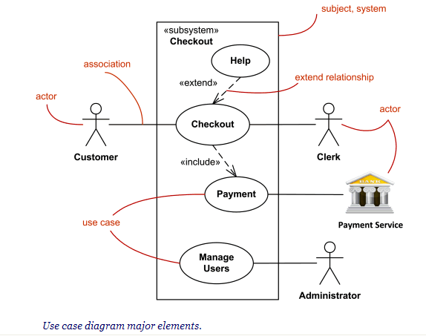
Use Case Diagrams
Major elements of the use case diagram are shown on the picture below.

Slide 31
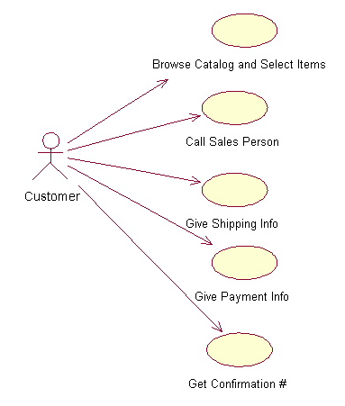
Use-Case Diagrams: Example
The salesperson could also be included in this use case diagram because the salesperson is also interacting with the ordering system.
Notes:
From this simple diagram the requirements of the ordering system can easily be derived. The system will need to be able to perform actions for all of the use cases listed. As the project progresses other use cases might appear. The customer might have a need to add an item to an order that has already been placed. This diagram can easily be expanded until a complete description of the ordering system is derived capturing all of the requirements that the system will need to perform.

Slide 32
Relationship
There are four kinds of relationships
Association
Extend
Include
generalization
Notes:
32

Slide 33
Case Study: OOAD of Simulated ATM
Developing a Use Case Diagram
The use case for a system represents all high-level behaviors (use cases) of the system and which actors that can participate in these behaviors.
To create the Use Case diagram, follow these steps:
1. Create and name the system boundary rectangle.
2. Identify all actors of the system from the SRS.
3. For each actor:
a. Add the actor icon to the diagram.
b. Add use cases to the diagram in which the actor
participates.
c. Draw the use case associations to that actor.

Slide 34

Checkpoints: Use-Case Model
Is the Use-Case Model understandable?
By studying the Use-Case Model, can you form a clear idea of the system's functions and how they are related?
Have all functional requirements been met?
Does the Use-Case Model contain any superfluous behavior?
Is the division of the model into use-case packages appropriate?
...
Notes:
The above, as well as the remaining checklists in this section, is a sample of the kinds of things to look for when reviewing the Use-Case Model. Explicit, detailed checklists should be established for the project to support the review of the Use-Case Model.
Verify that there are no open questions. The use cases you found must be able to perform all system behaviors; if not, some use cases are missing. If you intentionally left any requirements to be dealt with in the object models, such as nonfunctional requirements, you must mention this. Put the reference in the Supplementary Specification(s) unless the requirement concerns a specific use case, in which case state it in the Special Requirements section of the use case.
The Use-Case Model should not present more functions than were called for in the requirements.
Traceability from the original requirements to the use cases and the Supplementary Specification is critical for project management and impact assessment as well as to make sure nothing has been missed.
The packaging should make the Use-Case Model simple and intuitive to understand and maintain.

Slide 35
Checkpoints: Actors
Have all the actors been identified?
Is each actor involved with at least one use case?
Is each actor really a role? Should any be merged or split?
Do two actors play the same role in relation to a use case?
Do the actors have intuitive and descriptive names? Can both users and customers understand the names?
Notes:
Make sure that all the roles in the system's environment have been accounted for and modeled. You will not be able to do this fully until you have found and described all the use cases.
Remove any actors not mentioned in the use-case descriptions or that have no associations with a use case. However, an actor mentioned in a use-case description is likely to have a association with that particular use case.
You should be able to name at least two people who would be able to perform as a particular actor. If not, see if the role the actor models is part of another role. If so, you should merge the actors.
If any actors play similar roles in relation to the system, they should be merged into a single actor. If a particular actor will use the system in several completely different ways, or has several completely different purposes for using the use case, then there should probably be more than one actor.
If two actors play the same role in relation to a use case, then actor-generalizations should be used to model their generalized behavior.
It is important that actor names correspond to their roles.

Slide 36
Checkpoints: Use-Cases
Is each use case involved with at least one actor?
Is each use case independent of the others?
Do any use cases have very similar behaviors or flows of events?
Do the use cases have unique, intuitive, and explanatory names so that they cannot be mixed up at a later stage?
Do customers and users alike understand the names and descriptions of the use cases?
Notes:
A use case that does not interact with an actor is superfluous. You should remove it.
If two use cases are always activated in the same sequence, you should probably merge them into one use case.
Use cases that have very similar behaviors or flows of events, or will be similar in the future, should be merged into a single use case. This makes it easier to introduce future changes.
Note: You must involve the users if you decide to merge use cases because the users, who interact with the new, merged use case will probably be affected.
If some part of the flow of events is already part of another use case, the sub-flow should be extracted and then be included by all of the use cases in question.
Note: You must involve the users if you decide to "reuse" the sub-flow, because the users of the existing use case will probably be affected.
Each use-case name must describe the behavior the use case supports. The names and descriptions must be understood by the users and customers.

Slide 37
Checkpoints: Use-Case Specifications
Is it clear who wants to perform a use case?
Is the purpose of the use case also clear?
Does the brief description give a true picture of the use case?
Is it clear how and when the use case's flow of events starts and ends?
Does the communication sequence between actor and use case conform to the user's expectations?
Are the actor interactions and exchanged information clear?
Are any use cases overly complex?
Notes:
Include any (nonfunctional) requirements in the use-case Special Requirements.
Behavior might exist that is activated only when a certain condition is not met. There should be a description of what will happen in such a case.
If you want your Use-Case Model to be easy to understand, you might have to split up complex use cases. A use case that contains disparate flows of events will be very difficult to understand and to maintain. It is best to divide such use cases into two or more separate ones.

Slide 38
Activity Diagram
Validating a Use Case With an Activity
Diagram
• Represent the Flow of Events of the use case in an
Activity diagram
• Validate the use case by reviewing the Activity
diagram with the stakeholders

Slide 39
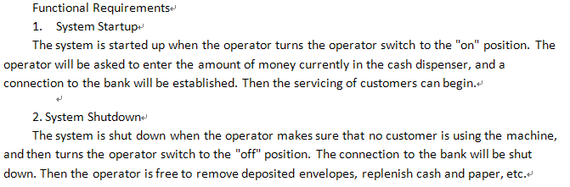
What Is an Activity Diagram?
An activity diagram in the Use-Case Model can be used to capture the activities in a use case.
It is essentially a flow chart, showing flow of control from one activity or action to another.
Activity2
Activity1
Activity3
Notes:
The workflow of a use case describes what needs to be done by the system to provide the value that the served actor is looking for.
It consists of a sequence of activities that, together, produce something for the actor.
The workflow often consists of a basic flow and one or several alternative flows.
The structure of the workflow can be described graphically with the help of an activity diagram.

Slide 40
OOSD Process & UML guide
Notes:
Requirements Analysis:Model how the system will support the use cases
Determine:
• A reﬁned Use Case diagram.
• What key abstractions exist in the system.

Slide 41
Example: Activity Diagram
Decision
Select Course
Activity/Action
Concurrent Threads
[ delete course ]
Delete Course
[ add course ]
Synchronization
Bar (Fork)
Guard
Condition
Check
Check
Schedule
Pre-requisites
Synchronization
Bar (Join)
[ checks completed ]
[ checks failed ]
Assign to
Resolve
Transition
Course
Conflicts
Update
Schedule
Notes:
An activity diagram may include the following elements:
Activity/Action represents the performance of a step within the workflow.
Transitions show the activity/action that follows.
Decisions evaluate conditions defined by guard conditions. These guard conditions determine which of the alternative transitions will be made and, thus, which activities are performed. You may also use the decision icon to show where the threads merge again. Decisions and guard conditions allow you to show alternative threads in the workflow of a use case.
Synchronization bars show parallel sub-flows. They allow you to show concurrent threads in the workflow of a use case.

Slide 42
Example of Activity Diagram
A Process : Creating a Document
Open the word processing package
Create a file
Save the file under a unique name within its directory
Type the document
If graphics are necessary, open the graphics package, create the graphics, and paste the graphics into the document
If spreadsheet are necessary, open the spreadsheet package, create the spreadsheet, and paste the spreadsheet into the document
Save the file
Print a hard copy of the document
Exit the office suite

Slide 43
example
Open Word Processing Package
Create File
Save File
Type the Document
[graphics needed]
Open and Use Graphics Package
[graphics not needed]
[tables needed]
Open and Use Spreedsheet
[tables not needed]
Save File
Print Hardcopy
Exit Office Suite

Slide 44
Partitions (Swimlanes)
show who has responsibility for each activity. (role)
A salesperson calls the client and sets up an appointment
Onsite appointment(In the consulting firm’s office) - corporate technicians prepare a conference room for a presentation
Offsite appointment(at the client’s office) - a consultant prepares a presentation on a laptop
The consultant and the salesperson meet with the client at the agreed-upon location and time
the salesperson follows up with a letter
If the meeting has resulted in a statement of a problem, the
benefit – the activities of each role are clarified
9

Slide 45
Partitions
Sales
Fulfillment
Determine
Need
Take Order
Fill Order
Setup Payment
Deliver Order
Notes:
An activity diagram may be partitioned using solid vertical lines.
Each partition should represent a responsibility for part of the overall workflow, carried by a part of the organization. A partition may eventually be implemented by an organization unit or a set of classes in the business object model.
The relative ordering of partitions has no semantic significance. Each action state is assigned to one partition, and activity edges may cross lanes.
This slide shows an activity diagram illustrating the workflow of a business use case that represents a (generic) sales process. In this example, the partitions represent departments in the organization.

Slide 46
Summary
• A Use Case diagram provides a visual representation
of the big-picture view of the system.
• The Use Case diagram represents the system, the actors that use the system, the use cases that provide a behavior with definable result for an actor, and the associations between actors and use cases.
• A Use Case scenario is written to provide a detailed
description of the activities involved in one instance of the use case.

Slide 47
Class diagram
Class diagrams are widely used to describe the types of objects in a system and their relationships
Each class is represented by a rectangle subdivided into three compartments
Name
Attributes
Operations
Notes:
Class diagrams describe three different perspectives when designing a system, conceptual, specification, and implementation.1 These perspectives become evident as the diagram is created and help solidify the design.

Slide 48
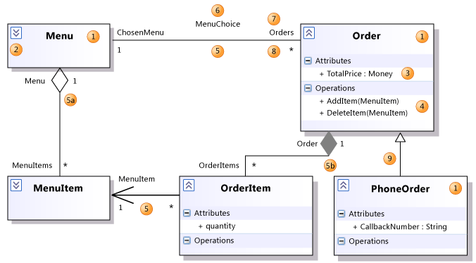
Class diagram
Notes:
1Class
A definition of objects that share given structural or behavioral characteristics. For more information, see Properties of Types in UML Class Diagrams.
1 Classifier
The general name for a class, interface, or enumeration. Components, use cases, and actors are also classifiers.
2 Collapse/ Expand control
If you cannot see the details of a classifier, click the expander at upper-left of the classifier. You might also have to click the [+] on each segment.
3 Attribute
A typed value attached to each instance of a classifier.
To add an attribute, click the Attributes section and then press ENTER. Type the signature of the attribute. For more information, see Properties of Attributes in UML Class Diagrams.
4 Operation
A method or function that can be performed by instances of a classifier. To add an operation, click the Operations section and then press ENTER. Type the signature of the operation. For more information, see Properties of Operations in UML Class Diagrams.
Reference:http://msdn.microsoft.com/en-us/library/dd409437.aspx

Slide 49
Creating a Domain Model
Starting with the key abstractions, you can create a Domain
model using these steps:
1. Draw a class node for each key abstraction, and:
a. List known attributes.
b. List known operations.
2. Draw associations between collaborating classes.
3. Identify and document relationship and role names.
4. Identify and document association multiplicity.
5. Identify and document association navigation.
6. Identify and document association classes.

Slide 50
Summary
• Use the Domain model to provide a static view of the
key abstractions for the problem domain.
•Use the UML Class diagrams to represent the Domain model.

Slide 51
State diagram
What is meant by the ‘state’ of an object?
Depends on attribute values, but
State is an abstraction
Should objects have lots of states, or a few?
Too many states makes object behaviour difficult to characterize/understand
Can consideration of state inform class design?
Split classes with too many states into simpler classes

Slide 52
State diagram
Basics
Describe the behaviour of individual model elements:
mostly used to model behaviour of objects
but, can be used for other things
Statechart diagrams consist of:
States of objects
Transitions between states
Events driving transitions
Actions performed by objects
Notes:
What is meant by the ‘state’ of an object?
Depends on attribute values, but
State is an abstraction
Should objects have lots of states, or a few?
Too many states makes object behaviour difficult to characterize/understand
Can consideration of state inform class design?
Split classes with too many states into simpler classes

Slide 53
States and Transitions
Simple states
Start state
inDebit
inCredit
Transitions
Basic statechart diagram for the Account class
End state
Notes:
State diagrams describe all of the possible states of an object as events occur. Each diagram usually represents objects of a single class and track the different states of its objects through the system.
Rounded Box represents the state of the object and arrows indicting the transition to the next state

Slide 54
Transitions and Events
transitions are triggered by events:
Name of event triggering the transition
open
withdraw
inDebit
Transitions between states depend on events
inCredit
deposit
close
close

Slide 55
Guard Conditions
Written alongside associated event:
event [guard]
e.g.
Condition must hold for event to trigger transition
withdraw(sum) [sum > balance]
inCredit
inDebit
deposit(sum) [sum > -balance]

Slide 56
Actions on Transitions
Written alongside event:
event / action
event [guard] / action
e.g.
Use where action depends on the transition
withdraw(sum)[sum > balance]/balance = balance - sum
inCredit
inDebit
deposit(sum)[sum > -balance]/balance = balance + sum
Notes:
Actions
Events typically bring about actions:
Events are things that happen to an object
e.g. receipt of a message
Actions are things that an object does
e.g. performing a computation, sending a message
Actions may be shown either:
on transitions
on states

Slide 57
Actions on States
Written within state:
entry / action
exit / action
e.g.
Use where action depends on state
inDebit
entry / balance = balance - penalty

Slide 58
ATM Case Study: State Diagram for Account Class
exit /balance = 0
withdraw(sum) /balance -=sum
withdraw(sum) /balance -=sum
withdraw(sum) [sum >balance] /balance -=sum
inCredit
inDebit
entry/balance -= pen
deposit(sum) [sum >= balance] /balance += sum
deposit(sum) /balance+=sum
deposit(sum) /balance+=sum
close
close

Slide 59
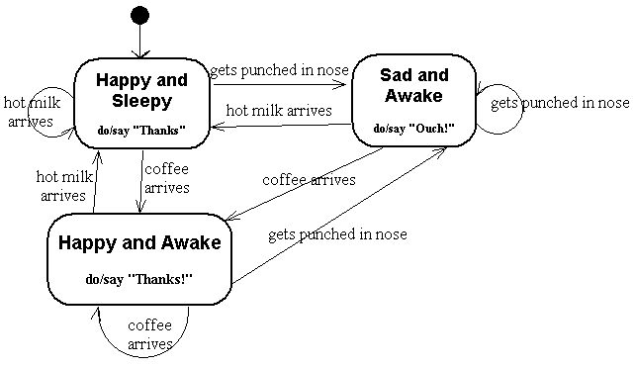
ATM Case Study: State Diagram for Account Class
Notes:
Reference: http://www.eagleridgetech.com/pr_state_diagrams.html

Slide 60
Summary
Objects have state and behaviour
behaviour depends on state
Statechart diagrams describe object behaviour
events trigger transitions between states
transitions may depend on guard conditions
events can result in actions
Activity diagrams
share much notation with state diagrams
different purpose

Slide 61
Use-Case Analysis
Explain the purpose of Use-Case Analysis and where in the lifecycle it is performed
Identify the classes which perform a use-case flow of events
Distribute the use-case behavior to those classes, identifying responsibilities of the classes
Develop Use-Case Realizations that model the collaborations between instances of the identified classes
Notes:
Use-Case Analysis is where the “Requirements meet OO.”
Use-Case Analysis is where we identify the initial classes of our system.
As the analysis classes are defined and the responsibilities are allocated to them, we will also note the usage of architectural mechanisms, more specifically, the usage of any analysis mechanisms defined in Architectural Analysis.
The analysis classes and the initial Use-Case Realizations are the key model elements being developed in this activity. These will be refined in the remaining Analysis and Design activities.

Slide 62
Use-Case Analysis Overview
Project Specific
Guidelines
Software
Architecture
Document
Use-Case Realization
Glossary
Use-Case
Analysis
Supplementary
Specifications
Analysis Model
Use-Case Model
Analysis Classes
Notes:
Use-Case Analysis is performed by the designer, once per iteration per Use-Case Realization. What event flows, and therefore what Use-Case Realizations you are going to work on during the current iteration are defined prior to the start of Use-Case Analysis in Architectural Analysis.
Purpose
To identify the classes that perform a use case’s flow of events
To distribute the use case behavior to those classes, using Use-Case Realizations
To identify the responsibilities, attributes and associations of the classes
To note the usage of architectural mechanisms
Input Artifacts
Glossary
Supplementary Specifications
Use-Case
Use-Case Model
Use-Case Realization
Etc.
Resulting Artifacts
Analysis Classes
Analysis Model
Use-Case Realizations
Note: We will not be developing a separate Analysis Model in this course.

Slide 63
Use-Case Analysis and Realization
Supplement the Use-Case Description
For each Use-Case Realization
Find Classes from Use-Case Behavior
Distribute Use-Case Behavior to Classes
For each resulting analysis class
Describe Responsibilities
Describe Attributes and Associations
Use-Case realization
Checkpoints
Notes:
This is a preview of what we will be doing in Use-Case Analysis.
The above are the major steps of the Use-Case Analysis activity.
First we must review the use-case descriptions developed in the Requirements discipline. Chances are, they will need some enhancements to include enough detail to begin developing a model.
Next, we study the use-case flow of events, identify analysis classes, and allocate use-case responsibilities to the analysis classes. Based on these allocations, and the analysis class collaborations, we can begin to model the relationships between the identified analysis classes.
Once the use case has been analyzed, we need to take a good look at the identified classes, making sure they are thoroughly documented and identify which analysis and mechanisms they implement.
Last, but not least, we need to make sure that our developed Analysis Model is consistent.

Slide 64
Review: Use-Case Realization
Use-Case Model
Design Model
Use Case
Use-Case Realization
Communication Diagrams
Sequence Diagrams
Use Case
Class Diagrams
Notes:
As discussed in the Analysis and Design Overview module, a Use-Case Realization describes how a particular use case is realized within the Design Model in terms of collaborating objects. A Use-Case Realization in the Design Model can be traced to a use case in the Use-Case Model. A realization relationship is drawn from the Use-Case Realization to the use case it realizes.
A Use-Case Realization is one possible realization of a use case. A Use-Case Realization can be represented using a set of diagrams (the number and type may vary by project).
Interaction diagrams (Sequence and/or Communication diagrams) can be used to describe how the use case is realized in terms of collaborating objects. These diagrams model the detailed collaborations of the Use-Case Realization.
Class diagrams can be used to describe the classes that participate in the realization of the use case, as well as their supporting relationships. These diagrams model the context of the Use-Case Realization.
During analysis activities (Use-Case Analysis), the Use-Case Realization diagrams are outlined. In subsequent design activities (Use-Case Design), these diagrams are refined and updated according to more formal class interface definitions.

Slide 65
Find Classes from Use-Case Behavior
The complete behavior of a use case has to be distributed to analysis classes
Notes:
The technique for finding analysis classes described in this module uses three different perspectives of the system to drive the identification of candidate classes. These three perspectives are:
The boundary between the system and its actors
The information the system uses
The control logic of the system
The use of stereotypes to represent these perspectives (for example, boundary, control, and entity) results in a more robust model because they isolate those things most likely to change in a system: the interface/environment, the control flow, and the key system entities. These stereotypes are conveniences used during Analysis that disappear in Design.
Identification of classes means just that: They should be identified, named, and described briefly in a few sentences.
The different stereotypes are discussed in more detail throughout this module.

Slide 66
What Is an Analysis Class?
<<boundary>>
<<entity>>
System boundary
System information
<<control>>
<<boundary>>
System boundary
Use-case behavior coordination
<<entity>>
System information
Notes:
Analysis classes represent an early conceptual model for “things in the system that have responsibilities and behavior.” Analysis classes are used to capture a “first-draft” rough-cut of the Object Model of the system.
Analysis classes handle primarily functional requirements. They model objects from the problem domain. Analysis classes can be used to represent "the objects we want the system to support" without making a decision about how much of them to support with hardware and how much with software.
Three aspects of the system are likely to change:
The boundary between the system and its actors
The information the system uses
The control logic of the system
In an effort to isolate the parts of the system that will change, the following types of analysis classes are identified with a “canned” set of responsibilities:
Boundary
Entity
Control
Each of these types of analysis classes are discussed on the following slides.

Slide 67
What Is a Boundary Class?
Analysis class stereotype
Environment dependent.
Intermediates between the interface and something outside the system
Several Types
User interface classes
System interface classes
Device interface classes
One boundary class per actor/use-case pair
Notes:
A boundary class intermediates between the interface and something outside the system. Boundary classes insulate the system from changes in the surroundings (for example, changes in interfaces to other systems and changes in user requirements), keeping these changes from affecting the rest of the system.
A system can have several types of boundary classes:
User interface classes—Classes that intermediate communication with human users of the system.
System interface classes—Classes that intermediate communication with other systems. A boundary class that communicates with an external system is responsible for managing the dialog with the external system; it provides the interface to that system for the system being built.
Device interface classes—Classes that provide the interface to devices which detect external events. These boundary classes capture the responsibilities of the device or sensor.
One recommendation for the initial identification of boundary classes is one boundary class per actor/use-case pair.

Slide 68
Example: Finding Boundary Classes
Student
Register for Courses
Course Catalog
RegisterForCoursesForm
CourseCatalogSystem
One boundary class per actor/use case pair
Notes:
The goal of Analysis is to form a good picture of how the system is composed, not to design every last detail. In other words, identify boundary classes only for phenomena in the system or for things mentioned in the flow of events of the Use-Case Realization.
One recommendation for the initial identification of boundary classes is one boundary class per actor/use-case pair. This class can be viewed as having responsibility for coordinating the interaction with the actor. This may be refined as a more detailed analysis is performed. This is particularly true for window-based GUI applications where there is typically one boundary class for each window, or one for each dialog box.

Slide 69
Guidelines: Boundary Class
Concentrate on the responsibilities, not the details!
User Interface Classes
Concentrate on what information is presented to the user
Do NOT concentrate on the UI details
System and Device Interface Classes
Concentrate on what protocols must be defined
Do NOT concentrate on how the protocols will be implemented
Notes:
When identifying and describing analysis classes, be careful not to spend too much time on the details. Analysis classes are meant to be a first cut at the abstractions of the system. They help to clarify the understanding of the problem to be solved and represent an attempt at an idealized solution (Analysis has been called “idealized Design”).
User Interface Classes: Boundary classes may be used as “holding places” for GUI classes. The objective is not to do GUI design in this analysis, but to isolate all environment-dependent behavior. The expansion, refinement and replacement of these boundary classes with actual user-interface classes (probably derived from purchased UI libraries) is a very important activity of Class Design and will be discussed in the Class Design module.
System and Device Interface Classes: If the interface to an existing system or device is already well-defined, the boundary class responsibilities should be derived directly from the interface definition. If there is a working communication with the external system or device, make note of it for later reference during design.

Slide 70
What Is an Entity Class?
Analysis class stereotype
Business-Domain
Model
Use Case
Architectural Analysis Abstractions
Glossary
Environment independent.
Key abstractions of the system
Notes:
Entity objects represent the key concepts of the system being developed. Entity classes provide another point of view from which to understand the system, because they show the logical data structure. Knowing the data structure can help you understand what the system is supposed to offer its users.
Frequent sources of inspiration for entity classes are the:
Glossary (developed during requirements)
Business-Domain Model (developed during business modeling, if business modeling has been performed)
Use-case flow of events (developed during requirements)
Key abstractions (identified in Architectural Analysis)
As mentioned earlier, sometimes there is a need to model information about an actor within the system. This is not the same as modeling the actor (actors are external. by definition). In this case, the information about the actor is modeled as an entity class. These classes are sometimes called “surrogates or proxies.”

Slide 71
Example: Finding Entity Classes
Use use-case flow of events as input
Key abstractions of the use case
Traditional, filtering nouns approach
Underline noun clauses in the use-case flow of events
Remove redundant candidates
Remove vague candidates
Remove actors (out of scope)
Remove implementation constructs
Remove attributes (save for later)
Remove operations
Notes:
Taking the use-case flow of events as input, underline the noun phrases in the flow of events. These form the initial candidate list of analysis classes.
Next, go through a series of filtering steps where some candidate classes are eliminated. This is necessary due to the ambiguity of the English language. The result of the filtering exercise is a refined list of candidate entity classes. While the filtering approach does add some structure to what could be an ad-hoc means of identifying classes, people generally filter as they go rather than blindly accepting all nouns and then filtering.

Slide 72
Example: Candidate Entity Classes
CourseOffering
Schedule
Student
Register for Courses (Create Schedule)
Notes:
The following are the definitions for each of the classes shown in the above diagram:
CourseOffering: A specific offering for a course, including days of the week and times.
Schedule: The courses a student has selected for the current semester.
Student: A person enrolled in classes at the university.
As mentioned earlier, sometimes there is a need to model information about an actor within the system. This is not the same as modeling the actor. (Actors are external by definition.) These classes are sometimes called “surrogates”.
For example, a course registration system maintains information about the student that is independent of the fact that the student also plays a role as an actor in the system. This information about the student is stored in a “Student” class that is completely independent of the “actor” role the student plays. The Student class will exist whether or not the student is an actor to the system.

Slide 73
What Is a Control Class?
Use Case
Analysis class stereotype
Use-case dependent. Environment independent.
Use-case behavior coordinator
More complex use cases generally require one or more control cases
Notes:
Control classes provide coordinating behavior in the system. The system can perform some use cases without control classes by using just entity and boundary classes. This is particularly true for use cases that involve only the simple manipulation of stored information. More complex use cases generally require one or more control classes to coordinate the behavior of other objects in the system. Examples of control classes include transaction managers, resource coordinators, and error handlers.
Control classes effectively decouple boundary and entity objects from one another, making the system more tolerant of changes in the system boundary. They also decouple the use-case specific behavior from the entity objects, making them more reusable across use cases and systems.
Although complex use cases may need more than one control class it is recommended, for the initial identification of control classes, that only one control class be created per use case.

Slide 74
Example: Finding Control Classes
In general, identify one control class per use case.
As analysis continues, a complex use case’s control class may evolve into more than one class
Student
Register for Courses
Course Catalog
System
RegistrationController
Notes:
One recommendation is to identify one control class per use case. However, this can become more than one use case as analysis continues. Remember that more complex use cases generally require one or more control cases. Each control class is responsible for orchestrating/controlling the processing that implements the functionality described in the associated use case.
In the above example, the RegistrationController <<control>> class has been defined to orchestrate the Register for Courses processing within the system.

Slide 75
Example: Summary: Analysis Classes
Student
Register for Courses
Course Catalog
System
Use-Case Model
Design Model
RegisterForCoursesForm
CourseCatalogSystem
Student
Schedule
CourseOffering
RegistrationController
Notes:
For each Use-Case Realization, there is one or more class diagrams depicting its participating classes, along with their relationships. These diagrams help to ensure that there is consistency in the use-case implementation across subsystem boundaries. Such class diagrams have been called “View of Participating Classes” diagrams (VOPC, for short).
The diagram on this slide shows the classes participating in the “Register for Courses” use case. Class relationships will be discussed later in this module.]

Slide 76
Use-Case Analysis Steps
Supplement the Use-Case Descriptions
For each Use-Case Realization
Find Classes from Use-Case Behavior
Distribute Use-Case Behavior to Classes
For each resulting analysis class
Describe Responsibilities
Describe Attributes and Associations
Qualify Analysis Mechanisms
Use-Case realization
Checkpoints
Notes:
Now that we have identified the candidate analysis classes, we need to allocate the responsibilities of the use case to the analysis classes and model this allocation by describing the way the class instances collaborate to perform the use case in Use-Case Realization.
The purpose of “Distribute Use-Case Behavior to Classes” is to:
Express the use-case behavior in terms of collaborating analysis classes
Determine the responsibilities of analysis classes

Slide 77
Distribute Use-Case Behavior to Classes
Use-Case Realization
Communication Diagrams
Sequence Diagrams
Use Case
Class Diagrams
For each use-case flow of events:
Identify analysis classes
Allocate use-case responsibilities to analysis classes
Model analysis class interactions in Interaction diagrams
Notes:
You can identify analysis classes responsible for the required behavior by stepping through the flow of events of the use case. In the previous step, we outlined some classes. Now it is time to see exactly where they are applied in the use-case flow of events.
In addition to the identified analysis classes, the Interaction diagram should show interactions of the system with its actors. The interactions should begin with an actor, since an actor always invokes the use case. If you have several actor instances in the same diagram, try keeping them in the periphery of that diagram.
Interactions between actors should not be modeled. By definition, actors are external, and are out of scope of the system being developed. Thus, you do not include interactions between actors in your system model. If you need to model interactions between entities that are external to the system that you are developing (for example, the interactions between a customer and an order agent for an order-processing system), those interactions are best included in a Business Model that drives the System Model.
Guidelines for how to distribute behavior to classes are described on the next slide.

Slide 78
Guidelines: Allocating Responsibilities to Classes
Use analysis class stereotypes as a guide
Boundary Classes
Behavior that involves communication with an actor
Entity Classes
Behavior that involves the data encapsulated within the abstraction
Control Classes
Behavior specific to a use case or part of a very important flow of events
Notes:
The allocation of responsibilities in analysis is a crucial and sometimes difficult activity. These three stereotypes make the process easier by providing a set of canned responsibilities that can be used to build a robust system. These predefined responsibilities isolate the parts of the system that are most likely to change: the interface (boundary classes), the use-case flow of events (control classes), and the persistent data (entity classes).

Slide 79
The Anatomy of Sequence Diagrams
Client Object
Supplier Object
:Client
Message
:Supplier
Object Lifeline
Reflexive Message
1: PerformResponsibility
Execution
Occurrence
Event Occurrence
1.1: PerformAnother Responsibility
Hierarchical Message
Numbering
ref
Interaction Occurrence
Notes:
A Sequence diagram describes a pattern of interaction among objects, arranged in a chronological order. It shows the objects participating in the interaction and the messages they send.
An object is shown as a vertical dashed line called the "lifeline." The lifeline represents the existence of the object at a particular time. An object symbol is drawn at the head of the lifeline, and shows the name of the object and its class separated by a colon and underlined.
A message is a communication between objects that conveys information with the expectation that activity will result. A message is shown as a horizontal solid arrow from the lifeline of one object to the lifeline of another object. For a reflexive message, the arrow starts and finishes on the same lifeline. The arrow is labeled with the name of the message and its parameters. The arrow may also be labeled with a sequence number.
Execution Occurrence represents the relative time that the flow of control is focused in an object, thereby representing the time an object is directing messages. Execution occurrence is shown as narrow rectangles on object lifelines.
Event Occurrence represents the sending or receipt of messages.
Interaction Occurrence is a reference to an interaction within the definition of another interaction.
Hierarchical numbering bases all messages on a dependent message. The dependent message is the message whose execution occurrence the other messages originate in. For example, message 1.1 depends on message 1.

Slide 80
Example: Sequence Diagram
: Student
: RegisterForCoursesForm
: RegistrationController
: CourseCatalogSystem
: Course Catalog
1: // create schedule( )
2: // get course offerings( )
Create a new
3: // get course offerings(forSemester)
schedule
4: // get course offerings( )
A list of the available
5: // display course offerings( )
course offerings for this
semester are displayed
A blank schedule
6: // display blank schedule( )
is displayed for the
students to select
offerings
ref
Select Offerings
ref
Submit Schedule
Notes:
The above example shows the object interactions to support the Create a Schedule sub-flow of the Register for Courses use case. Some of the rationale for responsibility allocation is as follows:
The RegisterForCoursesForm knows what data it needs to display and how to display it. It does not know where to go to get it. That is one of the RegistrationController’s responsibilities.
Only the RegisterForCoursesForm interacts with the Student actor.
Only the CourseCatalogSystem class interacts with the external legacy Course Catalog System.
Note the inclusion of the actors. This is important as the diagram explicitly models what elements communicate with the “outside world.”

Slide 81
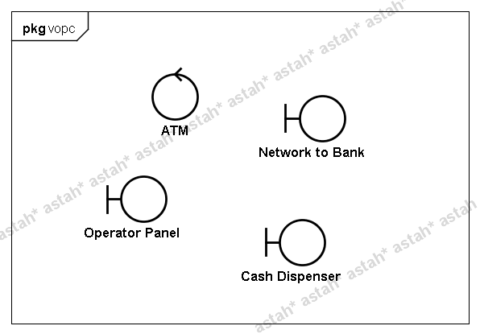
Case Study: ATM Startup
VOPC

Slide 82
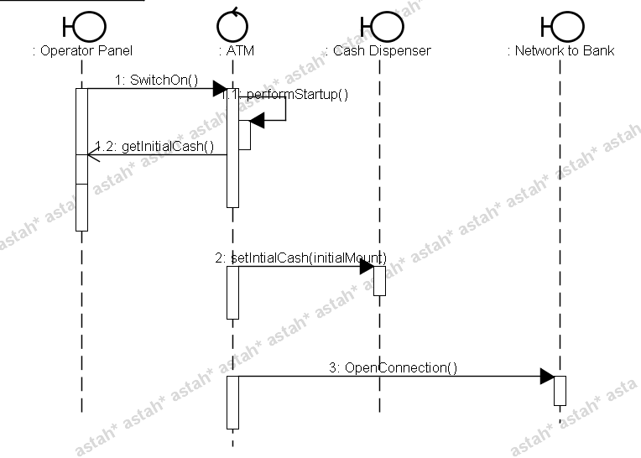
Case Study: ATM Startup
Sequence diagram

Slide 83
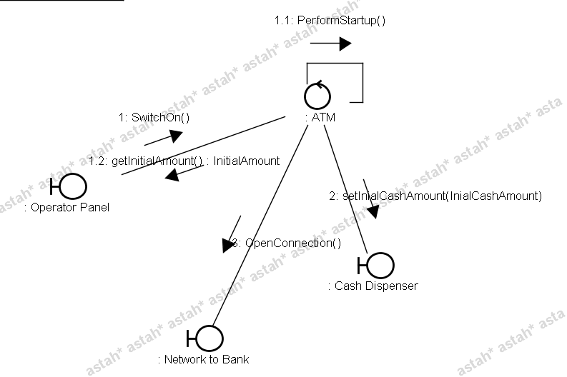
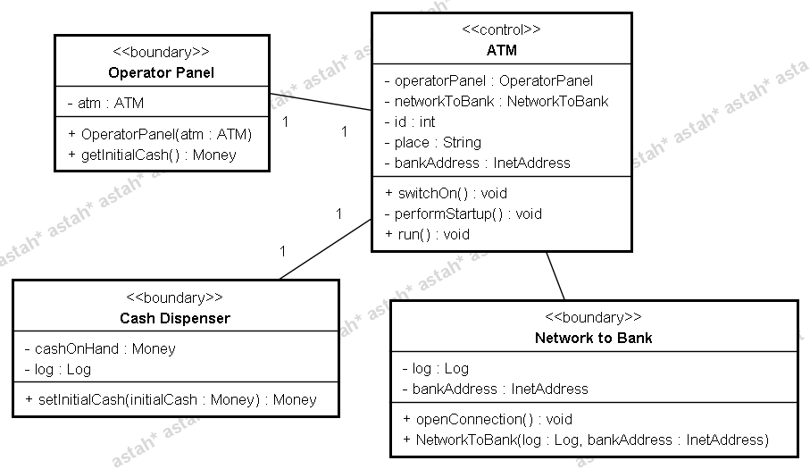
Case Study: ATM Startup
Attributes & responsibility

Slide 84
Use-Case Analysis Steps
Supplement the Use-Case Descriptions
For each Use-Case Realization
Find Classes from Use-Case Behavior
Distribute Use-Case Behavior to Classes
For each resulting analysis class
Describe Responsibilities
Describe Attributes and Associations
Qualify Analysis Mechanisms
Use-Case realization
Checkpoints
Notes:
This is where the quality of the model up to this point is assessed against some very specific criteria.
In this module, we will concentrate on those checkpoints that the designer is most concerned with (that is, looks for).

Slide 85

Checkpoints: Classes
Are the classes reasonable?
Does the name of each class clearly reflect the role it plays?
Does the class represent a single well-defined abstraction?
Are all attributes and responsibilities functionally coupled?
Does the class offer the required behavior?
Are all specific requirements on the class addressed?
Notes:
The above checkpoints for the analysis classes might be useful.
Note: All checkpoints should be evaluated with regards to the use cases being developed for the current iteration.
The class should represent a single well-defined abstraction. If not, consider splitting it.
The class should not define any attributes or responsibilities that are not functionally coupled to the other attributes or responsibilities defined by that class.
The classes should offer the behavior the Use-Case Realizations and other classes require.
The class should address all specific requirements on the class from the requirement specification.
Remove any attributes and relationships if they are redundant or are not needed by the Use-Case Realizations.

Slide 86
Checkpoints: Use-Case Realizations
Have all the main and/or sub-flows been handled, including exceptional cases?
Have all the required objects been found?
Has all behavior been unambiguously distributed to the participating objects?
Has behavior been distributed to the right objects?
Where there are several Interaction diagrams, are their relationships clear and consistent?
Notes:
The above checkpoints for the Use-Case Realizations might be useful.
Note: All checkpoints should be evaluated with regards to the use cases being developed for the current iteration.
The objects participating in a Use-Case Realization should be able to perform all of the behavior of the use case.
If there are several Interaction diagrams for the Use-Case Realization, it is important that it is easy to understand which Interaction diagrams relate to which flow of events. Make sure that it is clear from the flow of events description how the diagrams are related to each other.

Slide 87

Review: Use-Case Analysis
What is the purpose of Use-Case Analysis?
What is a Use-Case Realization?
What is an analysis class? Name and describe the three analysis stereotypes.
Describe some considerations when allocating responsibilities to analysis classes.
What two questions does multiplicity answer?

Slide 88
Exercise: Review
Compare your Use-Case Realization with the rest of the class
Do the Interaction diagrams carry out the use-case flow of events?
Are the stereotypes behaving properly?
Is each association supported by a link?
Does each association have multiplicity assigned?
Have role names been assigned? Do they accurately represent the face the class plays in the relationship?
Payroll System
Notes:
After completing a model, it is important to step back and review your work. Some helpful questions are the following:
Has the use case behavior been successfully represented in the model? In other words, is the flow of events the same in the specifications as it is in the model?
Has there been any significant behavior that was added? Removed? Changed? The model should reflect the intent of the Use-Case Specifications.
Is each stereotype behaving properly? Are actors only interfacing with boundary classes? Are control classes controlling the use-case flow of events only? Are any classes doing operations on data (attributes) that are not owned by that class?

Slide 89
Summary
the Object-Oriented Software Development (OOSD) process gives us a detailed demonstration of oo software development.
UML notations are used to represent different models of OOAD and main emphasis is put on OOD.
Different kinds of UML diagrams are used.

Slide 90
UML Resources
Books
Martin Fowler, Kendall Scott: UML Distilled, Addison-Wesley 2000
Grady Booch, et al: The Unified Modeling Language User Guide, Addison-Wesley
James Rumbaugh, et al: The Unified Modeling Language Reference Manual, Addison-Wesley Ivar Jacobson, et al: Unified Software Development Process, Addison-Wesley
Online UML Resources
Rational Software – UML Resource Center (http://www.rational.com/uml/index.jsp), UML Quick Reference (http://www.rational.com/uml/resources/quick/index.jsp), UML Whitepapers (http://www.rational.com/uml/resources/whitepapers/index.jsp) Recommended Books (http://www.rational.com/uml/reading/index.jsp) UML Cafe (http://cafe.rational.com/HyperNews/get/hn/umlcafe.html)

Slide 91
UML Resources
The Object Management Group -- UML resource Page (http://www.omg.org/technology/uml/index.htm), UML Tutorial (http://cgi.omg.org/news/pr97/umlprimer.html)
The UML Center -- UML Information (http://atlas.kennesaw.edu/~dbraun/csis4650/A&D/UML_tutorial/resources.htm#1) UML Events (http://atlas.kennesaw.edu/~dbraun/csis4650/A&D/UML_tutorial/resources.htm#evnts)
The UML Zone -- UML FAQ (http://www.uml-zone.com/umlfaq.asp) UML Q&A (http://news.devx.com/cgi-bin/dnewsweb.exe?utag=&group=vb.oop&xrelated=8577&cmd_related.x=69&cmd_related.y=6)
GDpro -- UML Center(http://www.gdpro.com/uml_central.html) UML Dictionary(http://softdocwiz.com/UML.htm)

